Slide 1
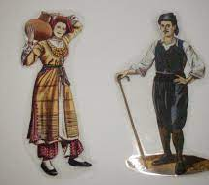
TRADITIONAL COSTUMES OF CYPRUS

Slide 2
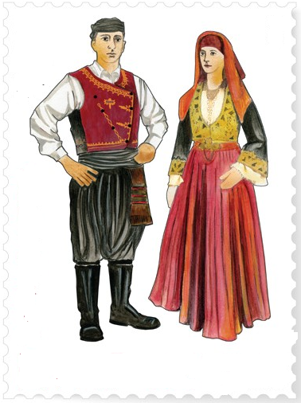
The traditional costumes of Cyprus are an integral component of our traditional culture.

Slide 3
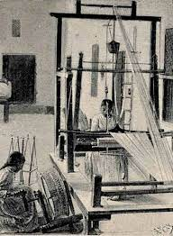
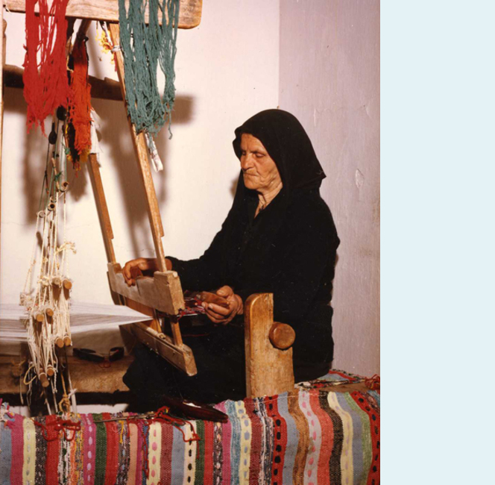
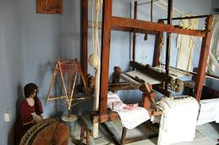
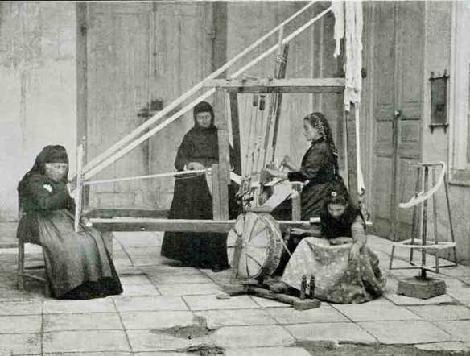
The Materials
The materials used for the costumes were cotton and silk.
Women weaving on argalios which is called “voufa”.

Slide 4
Male Costume

Slide 5
Male Costume
The yilekko
The Cypriot Male Costume basically consists of:
The zonari
The shirt
The vraka
The boots

Slide 6
The vraka
The vraka was made of coarse hand-woven dimity which was dyed after sewing by local dyers.

Slide 7
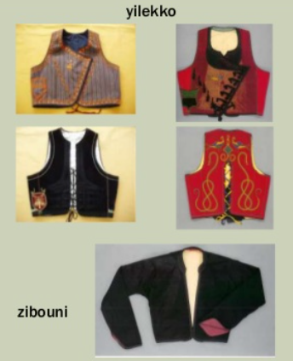
The Yilekko and the Zibouni
It is the short jacket worn with vraka over the shirt.

Slide 8
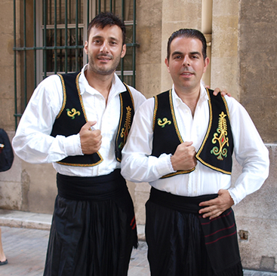
The Zonari
The zonari is a piece of clothe worn as a belt around the waist.

Slide 9
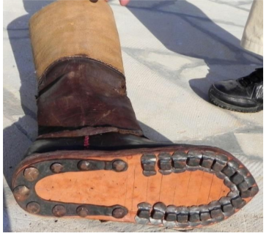
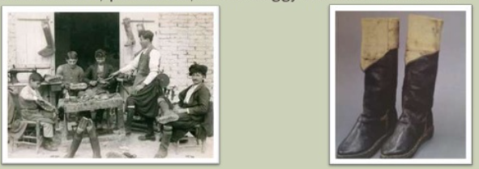
The boots (podines)
The men in the rural areas of Cyprus wore heavy hob-nailed boots to protect them from the snakes.
The boots were made by specialists called “scarbarides”.
These are the most expensive item of the male costume.

Slide 10
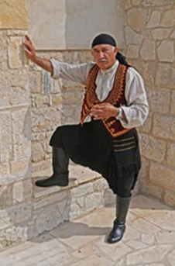
The headdress
The male costume was completed with a kerchief placed on the head.

Slide 11
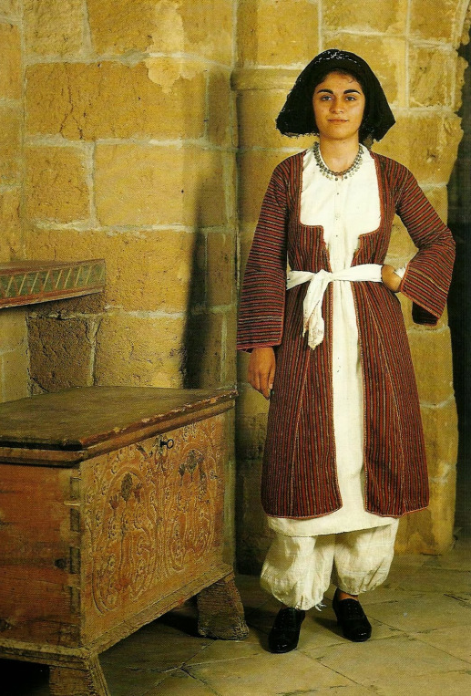
Female Costume
The Cypriot Female Costume basically consists of:
The headdress
The outer garment
The chemise
The distinctive long pantaloons caught around the ankle

Slide 12
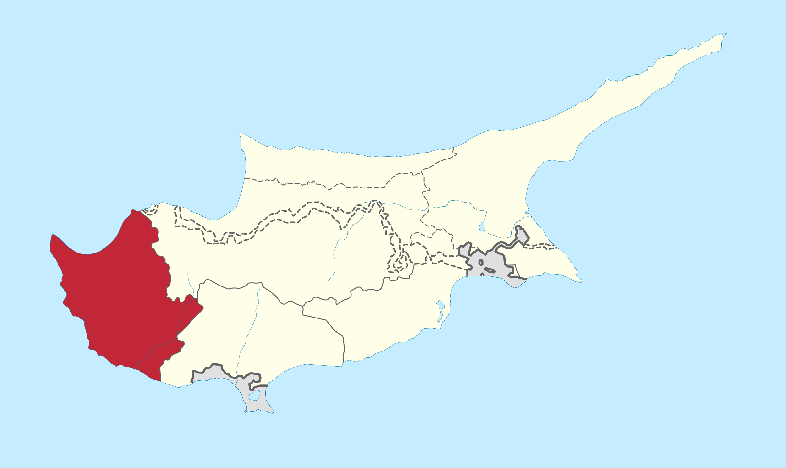
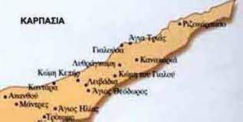
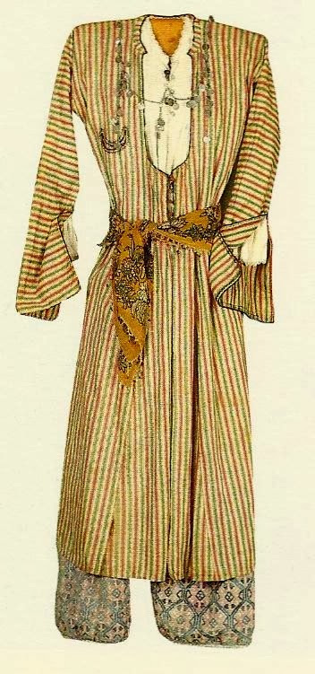
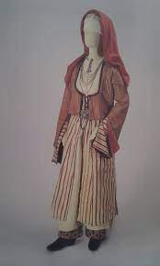
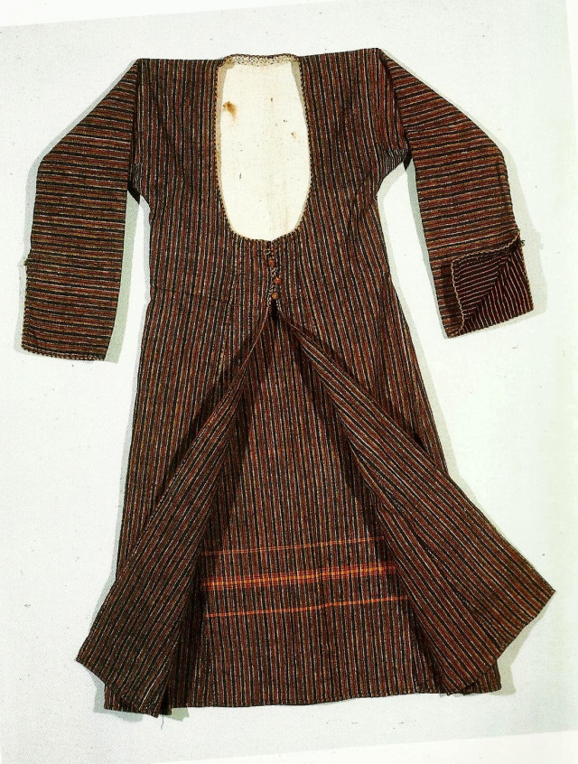
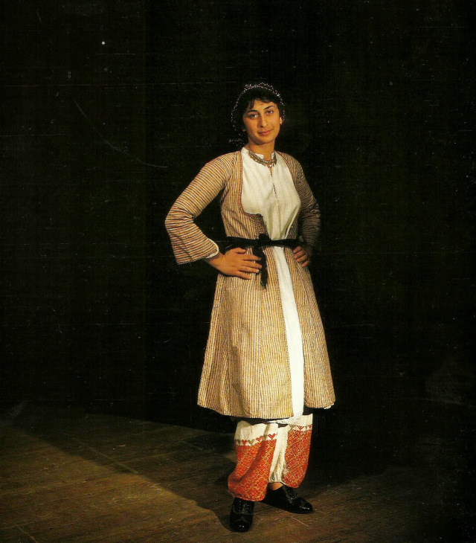
The Saya
Saya is a kind of dress open at the front and sides.
It was worn mainly at the area of Paphos and Rizokaspason.

Slide 13
The Saya

Slide 14
The Foystani with the apron
It is one pieced dress, worn in the rural areas of Cyprus. It is accompanied with an apron.
The apron

Slide 15
The Amalia Costume
It was worn in the urban areas of Cyprus..

Slide 16
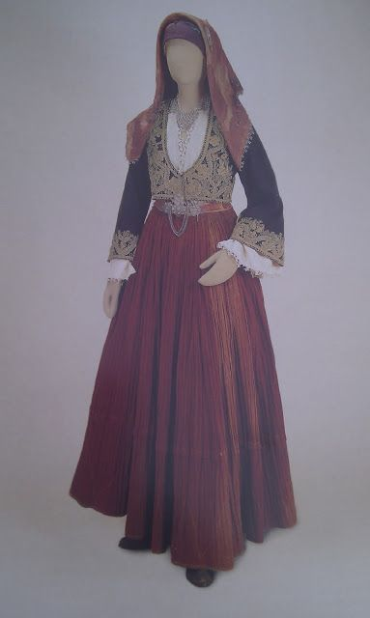
Bride with traditional costume

Slide 17
And now… our traditional costumes worn by Cypriots dancers

Slide 18
And now… our traditional costumes worn by Cypriots dancers

Slide 19
Thank you very much for your attention!!!

